Slide 1
Feature Selection
BAE LAB.
Department of Industrial Engineering, Pusan National University

Slide 2
이미지 기반 Feature Selection 새로운 방법론 필요성 대두
대표적인 이미지 유사도 측정 방법인 SSIM, MSE, 코사인 유사도는 이미지 특성상 대부분 흰 공간에 픽셀 몇 개만 다르기 때문에 일반적인 방법으로는 모두 유사하게 나옴(코사인 유사도는 0.99 이상이 나오는 것을 확인)
이 위의 문제점을 언급하고 새로운 방법론을 생각했다고 하면 너무 이쁠듯
이미지로 하지 말고 시계열의 값들을 코사인 유사도로 비교하면 어떨까?
유의미한 결과를 확인

Slide 3
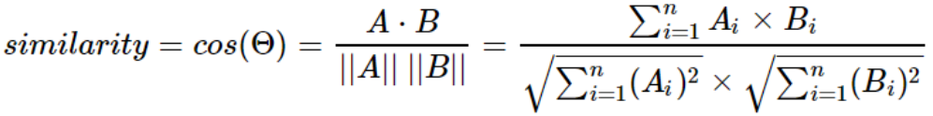
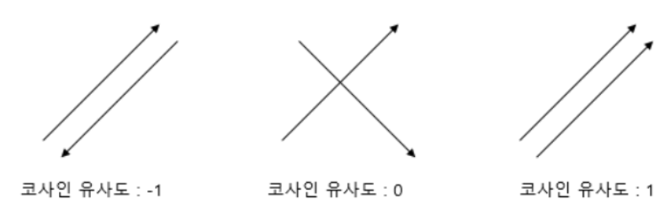
코사인 유사도
벡터와 벡터 간의 유사도를 비교할 때 두 벡터 간의 사잇각을 구해서 얼마나 유사한지 수치로 비교
시계열 데이터 값을 하나의 벡터로 생각하기!
만약 유사도를 계산해야 하는 두 시계열의 길이가 똑같다면, 유클리드 거리(Euclidean distance)나 코사인 유사도(cosine similarity)를 사용해서 시계열 간 유사도를 정의할 수 있습니다.
By NC Soft 블로그
공식

Slide 4
코사인 유사도
벡터와 벡터 간의 유사도를 비교할 때 두 벡터 간의 사잇각을 구해서 얼마나 유사한지 수치로 비교
시계열 데이터 값을 하나의 벡터로 생각하기!
만약 유사도를 계산해야 하는 두 시계열의 길이가 똑같다면, 유클리드 거리(Euclidean distance)나 코사인 유사도(cosine similarity)를 사용해서 시계열 간 유사도를 정의할 수 있습니다.
By NC Soft 블로그
공식

Slide 5
코사인 유사도
0.8은 절대적, 0.7은 비빌만함
서로 2개의 데이터가 유사한게 Feature Selection의 근거가 될까?
이거는 선배님들께 피드백을 받아야겠다.
Correlation에서는 Comprehensive를 채택하지 않았지만 코사인 유사도에서는 이를 채택. 나머지는 동일
Original data
Clarksons Average Containership Earnings
HSFO 380cst Bunker Prices (3.5% Sulphur), Rotterdam
Total Containerships - % Idle/Laid Up/Scrubber Retrofit
Total Containerships - % Idle/Laid Up/Scrubber Retrofit
Containership 1,650/1,850 TEU FCC, G'less Newbuilding Prices
Containership 13,000/14,000 TEU Newbuilding Prices
Containership 3,500/4,000 TEU (Wide Beam) G'less Newbuilding Prices
Containership 13,000/13,500 TEU G'less Newbuilding Prices
5 Year $10m Finance based on Libor 1st yr
Exchange Rates South Korea
Exchange Rates Euro
Exchange Rates China
Port Congestion Index - Containerships In Port, m.TEU, 7dma
Port Congestion Index - Containerships In Port, East Coast North America, m.TEU, 7dma
Port Congestion Index - Containerships In Port, West Coast North America, m.TEU, 7dma
Port Congestion Index - Containerships In Port, United Kingdom/Continent, m.TEU, 7dma
Port Congestion Index - Containerships In Port, Mediterranean/Black Sea, m.TEU, 7dma
Port Congestion Index - Containerships In Port, East Asia, m.TEU, 7dma
Port Congestion Index - Containerships In Port, South East Asia, m.TEU, 7dma
Port Congestion Index - Containerships In Port, China P.R., m.TEU, 7dma
+4 week lag
Clarksons Average Containership Earnings
HSFO 380cst Bunker Prices (3.5% Sulphur), Rotterdam
Total Containerships - % Idle/Laid Up/Scrubber Retrofit
Total Containerships - % Idle/Laid Up/Scrubber Retrofit
Containership 1,650/1,850 TEU FCC, G'less Newbuilding Prices
Containership 13,000/14,000 TEU Newbuilding Prices
Containership 3,500/4,000 TEU (Wide Beam) G'less Newbuilding Prices
Containership 13,000/13,500 TEU G'less Newbuilding Prices
5 Year $10m Finance based on Libor 1st yr
Exchange Rates South Korea
Exchange Rates Euro
Exchange Rates China
Port Congestion Index - Containerships In Port, m.TEU, 7dma
Port Congestion Index - Containerships In Port, East Coast North America, m.TEU, 7dma
Port Congestion Index - Containerships In Port, West Coast North America, m.TEU, 7dma
Port Congestion Index - Containerships In Port, United Kingdom/Continent, m.TEU, 7dma
Port Congestion Index - Containerships In Port, Mediterranean/Black Sea, m.TEU, 7dma
Port Congestion Index - Containerships In Port, East Asia, m.TEU, 7dma
Port Congestion Index - Containerships In Port, South East Asia, m.TEU, 7dma
Port Congestion Index - Containerships In Port, China P.R., m.TEU, 7dma
+8 week lag
Clarksons Average Containership Earnings
HSFO 380cst Bunker Prices (3.5% Sulphur), Rotterdam
Total Containerships - % Idle/Laid Up/Scrubber Retrofit
Total Containerships - % Idle/Laid Up/Scrubber Retrofit
Containership 1,650/1,850 TEU FCC, G'less Newbuilding Prices
Containership 13,000/14,000 TEU Newbuilding Prices
Containership 3,500/4,000 TEU (Wide Beam) G'less Newbuilding Prices
Containership 13,000/13,500 TEU G'less Newbuilding Prices
5 Year $10m Finance based on Libor 1st yr
Exchange Rates South Korea
Exchange Rates Euro
Exchange Rates China
Port Congestion Index - Containerships In Port, m.TEU, 7dma
Port Congestion Index - Containerships In Port, East Coast North America, m.TEU, 7dma
Port Congestion Index - Containerships In Port, West Coast North America, m.TEU, 7dma
Port Congestion Index - Containerships In Port, United Kingdom/Continent, m.TEU, 7dma
Port Congestion Index - Containerships In Port, Mediterranean/Black Sea, m.TEU, 7dma
Port Congestion Index - Containerships In Port, East Asia, m.TEU, 7dma
Port Congestion Index - Containerships In Port, South East Asia, m.TEU, 7dma
Port Congestion Index - Containerships In Port, China P.R., m.TEU, 7dma
-4 week lag
Clarksons Average Containership Earnings
HSFO 380cst Bunker Prices (3.5% Sulphur), Rotterdam
Total Containerships - % Idle/Laid Up/Scrubber Retrofit
Total Containerships - % Idle/Laid Up/Scrubber Retrofit
Containership 1,650/1,850 TEU FCC, G'less Newbuilding Prices
Containership 13,000/14,000 TEU Newbuilding Prices
Containership 3,500/4,000 TEU (Wide Beam) G'less Newbuilding Prices
Containership 13,000/13,500 TEU G'less Newbuilding Prices
5 Year $10m Finance based on Libor 1st yr
Exchange Rates South Korea
Exchange Rates Euro
Exchange Rates China
Port Congestion Index - Containerships In Port, m.TEU, 7dma
Port Congestion Index - Containerships In Port, East Coast North America, m.TEU, 7dma
Port Congestion Index - Containerships In Port, West Coast North America, m.TEU, 7dma
Port Congestion Index - Containerships In Port, United Kingdom/Continent, m.TEU, 7dma
Port Congestion Index - Containerships In Port, Mediterranean/Black Sea, m.TEU, 7dma
Port Congestion Index - Containerships In Port, East Asia, m.TEU, 7dma
Port Congestion Index - Containerships In Port, South East Asia, m.TEU, 7dma
Port Congestion Index - Containerships In Port, China P.R., m.TEU, 7dma
-4 week lag
Clarksons Average Containership Earnings
HSFO 380cst Bunker Prices (3.5% Sulphur), Rotterdam
Total Containerships - % Idle/Laid Up/Scrubber Retrofit
Total Containerships - % Idle/Laid Up/Scrubber Retrofit
Containership 1,650/1,850 TEU FCC, G'less Newbuilding Prices
Containership 13,000/14,000 TEU Newbuilding Prices
Containership 3,500/4,000 TEU (Wide Beam) G'less Newbuilding Prices
Containership 13,000/13,500 TEU G'less Newbuilding Prices
5 Year $10m Finance based on Libor 1st yr
Exchange Rates South Korea
Exchange Rates Euro
Exchange Rates China
Port Congestion Index - Containerships In Port, m.TEU, 7dma
Port Congestion Index - Containerships In Port, East Coast North America, m.TEU, 7dma
Port Congestion Index - Containerships In Port, West Coast North America, m.TEU, 7dma
Port Congestion Index - Containerships In Port, United Kingdom/Continent, m.TEU, 7dma
Port Congestion Index - Containerships In Port, Mediterranean/Black Sea, m.TEU, 7dma
Port Congestion Index - Containerships In Port, East Asia, m.TEU, 7dma
Port Congestion Index - Containerships In Port, South East Asia, m.TEU, 7dma
Port Congestion Index - Containerships In Port, China P.R., m.TEU, 7dma
0.96
0.95
0.95
0.96
0.96
0.67
0.66
0.64
0.67
0.67
0.33
0.32
0.33
0.33
0.27
0.35
0.35
0.35
0.35
0.32
Correlation도 lag에 따라서 이렇게 정리해주고
특정 feature에 대해서 최고의 lag를 찾기
0.65
0.62
0.59
0.64
0.64
0.88
0.86
0.84
0.88
0.88
0.84
0.82
0.81
0.85
0.85
0.95
0.94
0.93
0.95
0.95
0.12
0.13
0.13
0.12
0.12
0.57
0.55
0.53
0.57
0.56
0.69
0.69
0.69
0.7
0.72
0.29
0.3
0.31
0.29
0.29
0.86
0.85
0.84
0.86
0.86
0.91
0.9
0.88
0.91
0.91
0.93
0.93
0.93
0.93
0.93
0.88
0.86
0.86
0.88
0.88
0.72
0.69
0.68
0.72
0.72
0.55
0.55
0.54
0.55
0.55
0.71
0.71
0.71
0.71
0.71
0.55
0.55
0.53
0.55
0.55

Slide 6
Dynamic Time Warping 개선
DTW 문제
직관적으로 이해가 안됨 : 실장님께서도 언급하신 내용이지만 절대값을 취하는 이유와 MIN 값을 더해주는 것에 대해 확실하게 이해가 안됨
(관련 공부를 더 하고 싶어도 설명하는 곳이 부족)
그냥 있는 방법론을 가져와서 쓴 것인지 이 방법론에 대해서 나의 인사이트가 들어간 것이 전혀 없음
그냥 맘에 안듦
새로운 방법론에서 갖춰줘야 할 필수 요소
Lag와 Scaled된 데이터와 유사도를 비교할 때도 최소 DTW만큼의 성능이 보장
Sequence의 길이가 달라도 적용할 수 있어야 함
알맞은(?) 각 TimeStep을 연결해줘야 함 (DTW의 기능)
설명가능해야 함

Slide 7
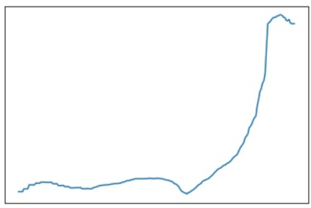
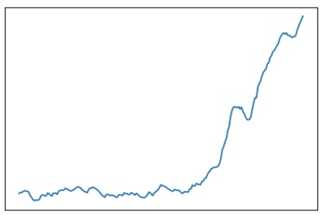
Dynamic Time Warping 개선 방법론
< Average Earnings>
< SCFI >
우리가 이 두 개의 그래프가 유사하다고 판단하는 근거는 지속된 횡보 이후에 떡상하는 형태이기 때문에
각 time step의 시계열 데이터 값에 집중하는 것이 아닌 time step 사이에 값의 변동에 집중 !
이를 위해서 Longest common subsequence에서 common subsequence만을 사용

Slide 8
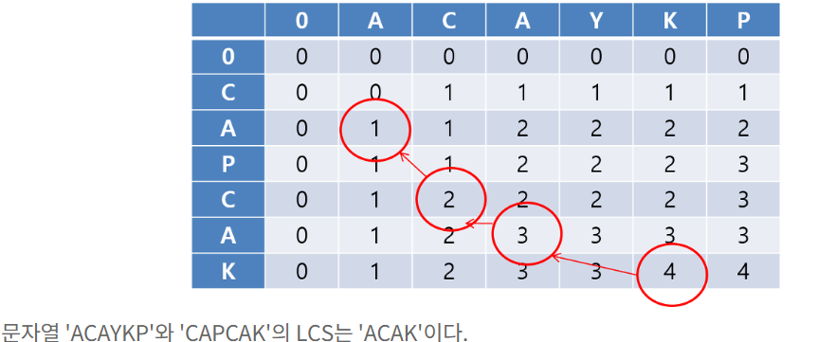
Dynamic Time Warping 개선 방법론
우리가

Slide 9
Conclusion
각 Feature Selection 방법론에서 공통 혹은 다수로 추출된 변수 최종 선택
Original data
Clarksons Average Containership Earnings
HSFO 380cst Bunker Prices (3.5% Sulphur), Rotterdam
Total Containerships - % Idle/Laid Up/Scrubber Retrofit
Total Containerships - % Idle/Laid Up/Scrubber Retrofit
Containership 1,650/1,850 TEU FCC, G'less Newbuilding Prices
Containership 13,000/14,000 TEU Newbuilding Prices
Containership 3,500/4,000 TEU (Wide Beam) G'less Newbuilding Prices
Containership 13,000/13,500 TEU G'less Newbuilding Prices
5 Year $10m Finance based on Libor 1st yr
Exchange Rates South Korea
Exchange Rates Euro
Exchange Rates China
Port Congestion Index - Containerships In Port, m.TEU, 7dma
Port Congestion Index - Containerships In Port, East Coast North America, m.TEU, 7dma
Port Congestion Index - Containerships In Port, West Coast North America, m.TEU, 7dma
Port Congestion Index - Containerships In Port, United Kingdom/Continent, m.TEU, 7dma
Port Congestion Index - Containerships In Port, Mediterranean/Black Sea, m.TEU, 7dma
Port Congestion Index - Containerships In Port, East Asia, m.TEU, 7dma
Port Congestion Index - Containerships In Port, South East Asia, m.TEU, 7dma
Port Congestion Index - Containerships In Port, China P.R., m.TEU, 7dma
Correlation Anlaysis
Clarksons Average Containership Earnings
HSFO 380cst Bunker Prices (3.5% Sulphur), Rotterdam
Total Containerships - % Idle/Laid Up/Scrubber Retrofit
Total Containerships - % Idle/Laid Up/Scrubber Retrofit
Containership 1,650/1,850 TEU FCC, G'less Newbuilding Prices
Containership 13,000/14,000 TEU Newbuilding Prices
Containership 3,500/4,000 TEU (Wide Beam) G'less Newbuilding Prices
Containership 13,000/13,500 TEU G'less Newbuilding Prices
5 Year $10m Finance based on Libor 1st yr
Exchange Rates South Korea
Exchange Rates Euro
Exchange Rates China
Port Congestion Index - Containerships In Port, m.TEU, 7dma
Port Congestion Index - Containerships In Port, East Coast North America, m.TEU, 7dma
Port Congestion Index - Containerships In Port, West Coast North America, m.TEU, 7dma
Port Congestion Index - Containerships In Port, United Kingdom/Continent, m.TEU, 7dma
Port Congestion Index - Containerships In Port, Mediterranean/Black Sea, m.TEU, 7dma
Port Congestion Index - Containerships In Port, East Asia, m.TEU, 7dma
Port Congestion Index - Containerships In Port, South East Asia, m.TEU, 7dma
Port Congestion Index - Containerships In Port, China P.R., m.TEU, 7dma
Image Similarity (MSE)
Clarksons Average Containership Earnings
HSFO 380cst Bunker Prices (3.5% Sulphur), Rotterdam
Total Containerships - % Idle/Laid Up/Scrubber Retrofit
Total Containerships - % Idle/Laid Up/Scrubber Retrofit
Containership 1,650/1,850 TEU FCC, G'less Newbuilding Prices
Containership 13,000/14,000 TEU Newbuilding Prices
Containership 3,500/4,000 TEU (Wide Beam) G'less Newbuilding Prices
Containership 13,000/13,500 TEU G'less Newbuilding Prices
5 Year $10m Finance based on Libor 1st yr
Exchange Rates South Korea
Exchange Rates Euro
Exchange Rates China
Port Congestion Index - Containerships In Port, m.TEU, 7dma
Port Congestion Index - Containerships In Port, East Coast North America, m.TEU, 7dma
Port Congestion Index - Containerships In Port, West Coast North America, m.TEU, 7dma
Port Congestion Index - Containerships In Port, United Kingdom/Continent, m.TEU, 7dma
Port Congestion Index - Containerships In Port, Mediterranean/Black Sea, m.TEU, 7dma
Port Congestion Index - Containerships In Port, East Asia, m.TEU, 7dma
Port Congestion Index - Containerships In Port, South East Asia, m.TEU, 7dma
Port Congestion Index - Containerships In Port, China P.R., m.TEU, 7dma
Dynamic Time Warping
Clarksons Average Containership Earnings
HSFO 380cst Bunker Prices (3.5% Sulphur), Rotterdam
Total Containerships - % Idle/Laid Up/Scrubber Retrofit
Total Containerships - % Idle/Laid Up/Scrubber Retrofit
Containership 1,650/1,850 TEU FCC, G'less Newbuilding Prices
Containership 13,000/14,000 TEU Newbuilding Prices
Containership 3,500/4,000 TEU (Wide Beam) G'less Newbuilding Prices
Containership 13,000/13,500 TEU G'less Newbuilding Prices
5 Year $10m Finance based on Libor 1st yr
Exchange Rates South Korea
Exchange Rates Euro
Exchange Rates China
Port Congestion Index - Containerships In Port, m.TEU, 7dma
Port Congestion Index - Containerships In Port, East Coast North America, m.TEU, 7dma
Port Congestion Index - Containerships In Port, West Coast North America, m.TEU, 7dma
Port Congestion Index - Containerships In Port, United Kingdom/Continent, m.TEU, 7dma
Port Congestion Index - Containerships In Port, Mediterranean/Black Sea, m.TEU, 7dma
Port Congestion Index - Containerships In Port, East Asia, m.TEU, 7dma
Port Congestion Index - Containerships In Port, South East Asia, m.TEU, 7dma
Port Congestion Index - Containerships In Port, China P.R., m.TEU, 7dma

Slide 10
Q&A

